Slide 1
United Airlines Controversy
Crisis Communication
Anqi Shen, Peiwei He, Yijun Zhang

Slide 2
1
Introduction

Slide 3
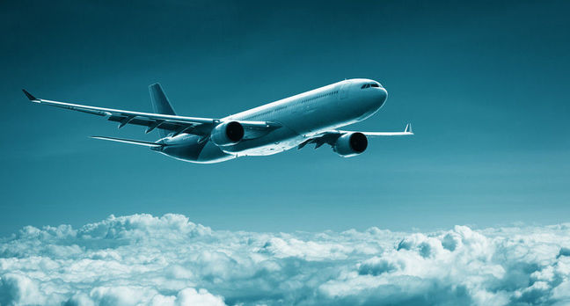
PART 1
United Airlines Controversy
United Airlines had a bad month.
Their airline officials and airport security dragged a doctor named David Dao off of an overbooked flight.
A bunch of passengers have been speaking up about their terrible United experiences, and finally it became international news.

Slide 4
PART 1
United Airlines Controversy Timeline
Sunday, April 9: A 69-year-old doctor named David Dao was forcibly removed from United Airlines Express.
Monday, April 10: Video of the incident recorded by passengers went viral on social media, resulting in outrage over the violent incident. Politicians expressed concern and called for official investigation. United Airlines issued its first response to the incident via Twitter. Apologize for having to re-accommodate customers. The internet went wild over Munoz's use of the word "re-accommodate.”
Monday, April 10: Later on April 10, in an e-mail to employees, Munoz praised and defended the crew's actions, while claiming the passenger was "disruptive and belligerent"

Slide 5
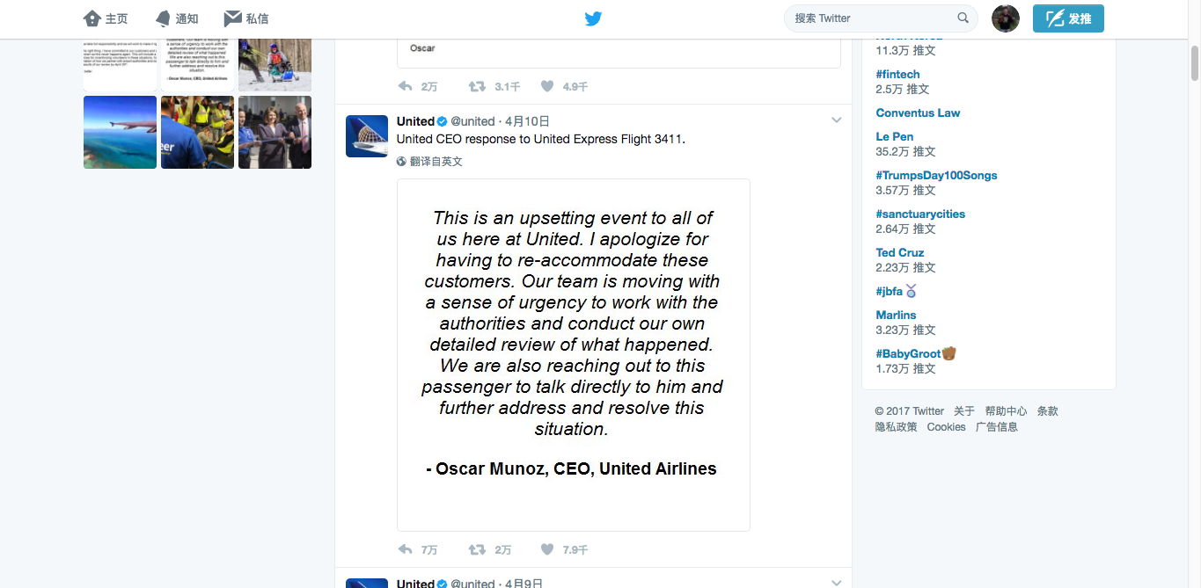

Slide 6
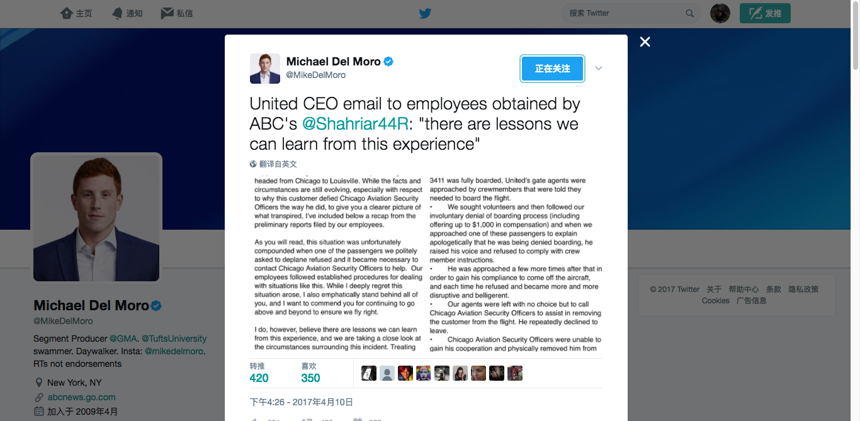

Slide 7
PART 1
United Airlines Controversy Timeline
Tuesday, April 11: Social media spawned some creative new slogans for the embattled company. Meanwhile, shares plunged nearly seven percent.
Tuesday, April 11: CEO issued yet another statement regarding the incident in which he took “full responsibility” and pledged to "make it right.”
Wednesday, April 12: The victim filed a “bill of discovery” against United Airlines in court.

Slide 8
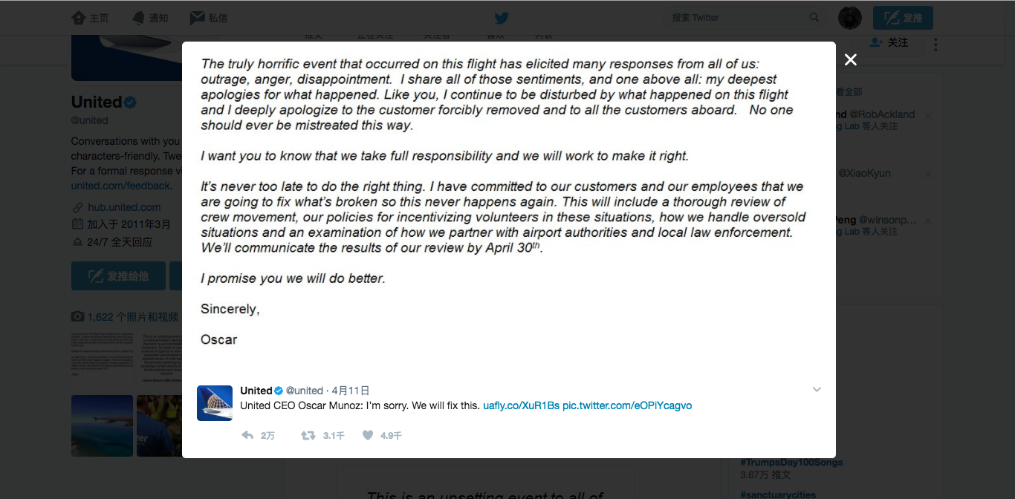

Slide 9
2
Research Question

Slide 10
PART 2
PART 1
Research Questions
请输入你的标题
Research Questions:
What’s information source of this crisis? What people create for message? How they create?
What are differences between transmitters? How they transmit this crisis?
How users encoded this news? How they feel?
What’s the noise in this processing?
What measures do company take? Does them work?
All in all, we want to analyze the whole communication of this crisis and give some advices.

Slide 11
3
Data Gathering

Slide 12
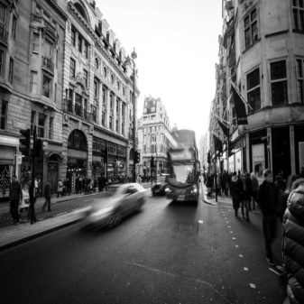



PART 1
PART 1
News Media Data
请输入你的标题
After using Selenium in python to scrape JS page, we got all news links from those websites.
Save it to a url lists.(Selenium is a browser simulator which helps me to paginate and get JS content )
Then using Rvest to scrape the content, title and time of the single page.
100
114
BBC
WS
Mail
17

Slide 13
PART 2
PART 1
Twitter Data
请输入你的标题
#UnitedAirlinesmemes
#boycottunitedairlines
#boycottunited
#unitedairlines
#UnitedAirlinesAssault
#dontflyunited
#NewUnitedAirlinesMottos
Set up Twitter API, using direct authentication.
Collect tweets by searching harshtags.
From April 10th to April 18th
60,000

Slide 14
4
Analysis

Slide 15
PART 1
PART 1
Analysis
请输入你的标题
Topic Model Building
Wordcloud Plot
Sentiment Analysis
Social Network Analysis

Slide 16
5
Results

Slide 17
5.1
Mass Media Website

Slide 18
News Media Coverage

Slide 19
News Media Sentiment
Sentiment of articles by Washington Post and New York Times are volatile. Compared to them, BBC treated it as a foreign business, so the fluctuation of sentiment of it was shown more flatten.

Slide 20
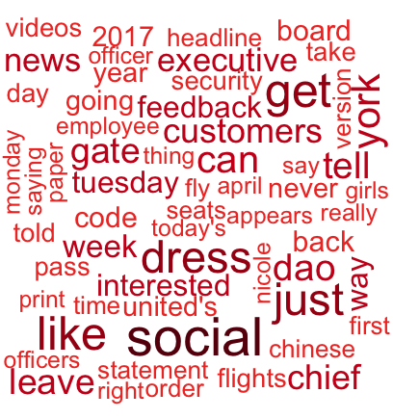
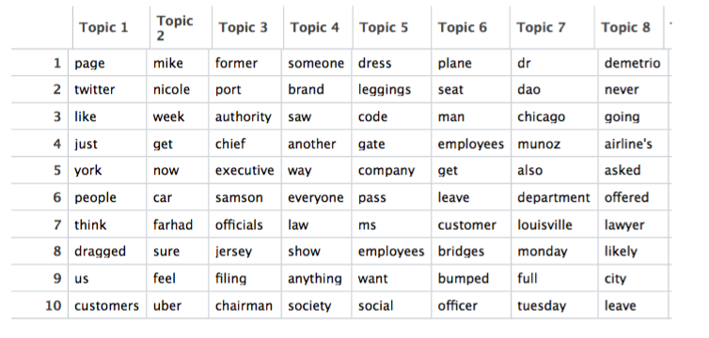
Word Clouds & Topics
New York Times
Emphasize the process of this
David Dao has been dragged out of the plane
Airport issues, Racist issues.

Slide 21
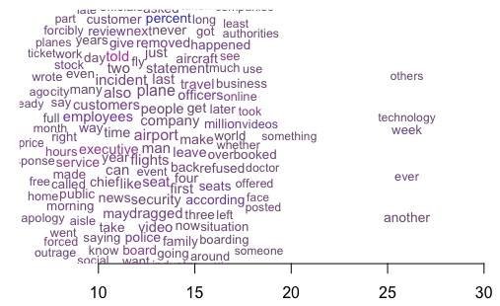
Topic Overtime
New York Times
Emphasized the process of whole incident.
And in the follow-up stories they began to dig the deep reasons of things happened.

Slide 22
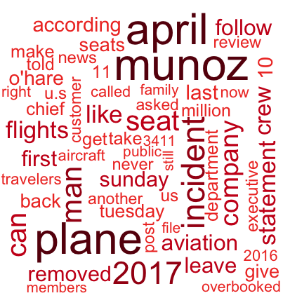
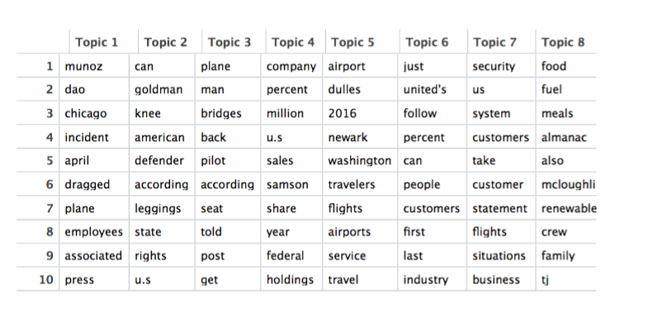
Word Clouds & Topics
Washington Post
Emphasize litigants including CEO and David Dao.
David Dao has been dragged out of the plane.
Human rights issues and company’s issues.

Slide 23
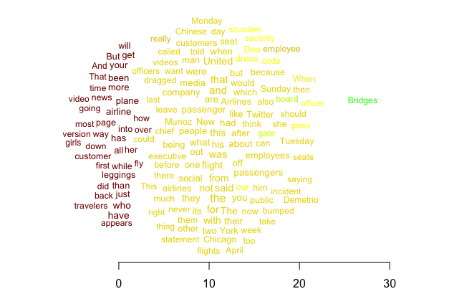
Topic Overtime
Washington Post
Emphasized litigants
There are reports citing about what twitter users said in internet.

Slide 24
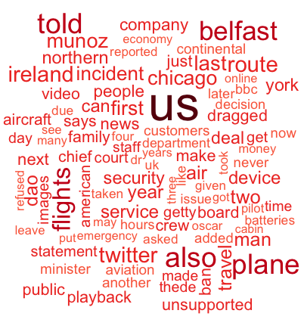
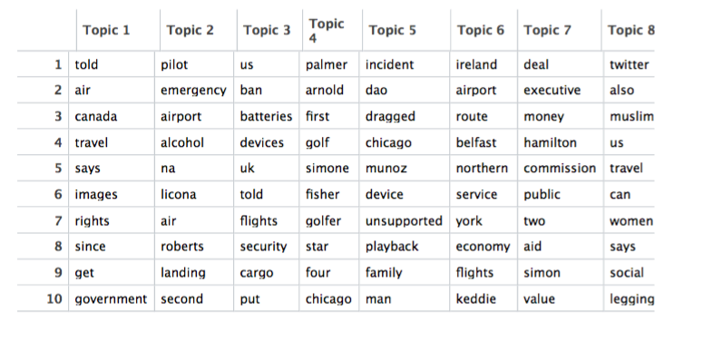
Word Clouds & Topics
BBC News
This news is generally a foreign business.
Former faults of United Airlines made in UK.
Airport security issues, Racist issues.

Slide 25
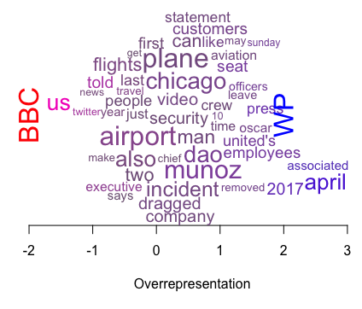
Keywords Comparison
Washington Post VS BBC news

Slide 26
Some Conclusions
Common points
Different points
All medium mentioned that video which recoded policemen re-accommodated that passenger , and several important public relationship measures by United Airlines
All medium avoided to use those words with Intense feeling. However, they described people are “outrange”and emphasized misdeed of United Airlines. Though they didn’t comment about what United did to deal with public relationship, their report gives me a impression that they treated their “crisis” pretty causally.
In content they have different choice
BBC just saw this as a foreign news

Slide 27
5.2
Twitter

Slide 28
PART 1
Twitter Count Changes
We collect 60,000 tweets by searching harshtags about United Airlines, and this line chart shows the distribution of tweets counts from April 10-18.
On April 12, the discussion on Twitter reached a peak.

Slide 29
Topic Model

Slide 30
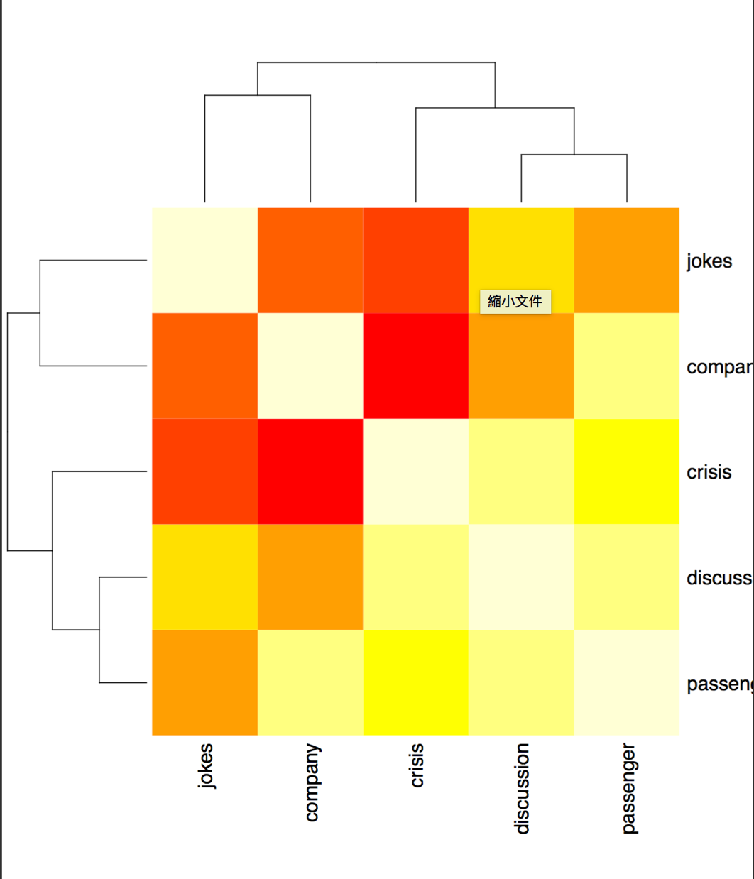
Topic Heat Map
The heat map revealed the relation between 2 topics, the most heated relation was between company and crisis, while users also made jokes with the United Airlines company.

Slide 31
PART 1
请输入你的标题
Repost Network
请输入你的标题
41103 Retweets
Gephi: Force Atlas
Average Degree: 1.224
Diameter: 6
Dense Network

Slide 32
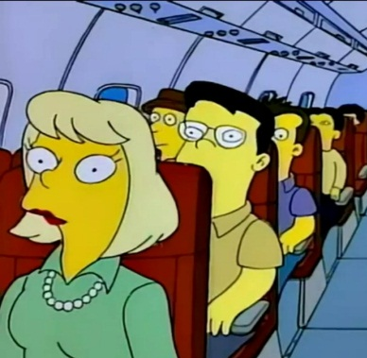
Repost - Symbolization
Spoof Video
Comics
@SFC_Airborne51
@ITZDANNNO
@Ali_8k
Post a video spoof using United Airlines’ advertisement
Whoever made this is genius
United Airlines new ad
@ascaniospread: Simpsons did it first
@Robo_Knight:
When the Megazord is overbooked and #unitedairlines wants you off

Slide 33
Repost – Negative Emotion
Disgusting
Worst
@civicaction:
Hey @United, when you treat your passengers as if they aren’t even human, WE SEE YOU
@LalitKModi: Absolutely the most #disgusting #behaviour by @united #unitedAIRLINES
@BeingFarhad: #BoycottUnitedAirlines Shame on you #unitedAIRLINES! Your airlines should be shut permanently! #worstairline

Slide 34
PART 1
Twitter Sentiment Changes
On April 11, the United Airlines released an official statement about the flight 3411, by the CEO, so the trend of tweets sentiment turns positive.
#NewUnitedAirlinesMottos From April 15-16, some videos spread quickly on Twitter, most videos are joking videos, for example, making new advertisements for UA with beating passenger's video.

Slide 35
请输入你的标题
请输入你的标题
333 Important Opinion Leaders
Retweets count large than 10000
Normalized retweet count(10000 is 1)
High influence users have high friends count or high followers count or both

Slide 36
06
Conclusion

Slide 37
PART 1
PART 1
Stages of Crisis Management
请输入你的标题
3 Chronic
4 Solution
Litigation occurs, media exposes are aired
Full apologize and corrective action
We will give some solutions
2 Crisis Breakout
1 Prodromal
Breakout on Apr. 9th
Excuse: deny and shift the blame to litigant
Negative impression(from 2016)
No crisis management

Slide 38
Information
Transmitter
News Media: Neutral and objective, tell what happened.
Twitter: Boycott United Airlines with strong emotion.
News Media: Text, pictures and video.
Twitter: Text, tags, photos(gif),comic and video.
Two-step Flow
Re-creation and Infotainment.
These two media have some interactions.

Slide 39
Receiver
KOL has great influence: High influence users have high friends count or high followers count or both.
Sparse network in Twitter: Not every one can be noticed and have a voice.
Herd Behavior(noise): Express negative emotion followed the masses.

Slide 40
PART 2
PART 1
Improvement
请输入你的标题
1. United Airlines should release news more timely, the video about policemen dragging that doctor was release at 9th April in twitter. However the apologetic letter was released at 10th April, it’s too late. Leave the time for negative opinion spreading.
2. Public opinions & emotions were arouse after the first apologetic letter realised. It proves that the content of first apologetic letter should be altered. We need to apologize more sincerely rather than ”denying” it by using words like “re-accommodation”.
3. By using some communication strategies like attacking the accusers ( those policemen in airport), drowning the negative information by paying money to opinion leaders. We might get better results.
4. We can use characteristics we have analyzed to find out opinion leaders.

Slide 41
T hanks

